Slide 1
Presentation on Wildlife Strikes between 2000 - 2015
-by Shashank Sadh
DA/DS - 22

Slide 2
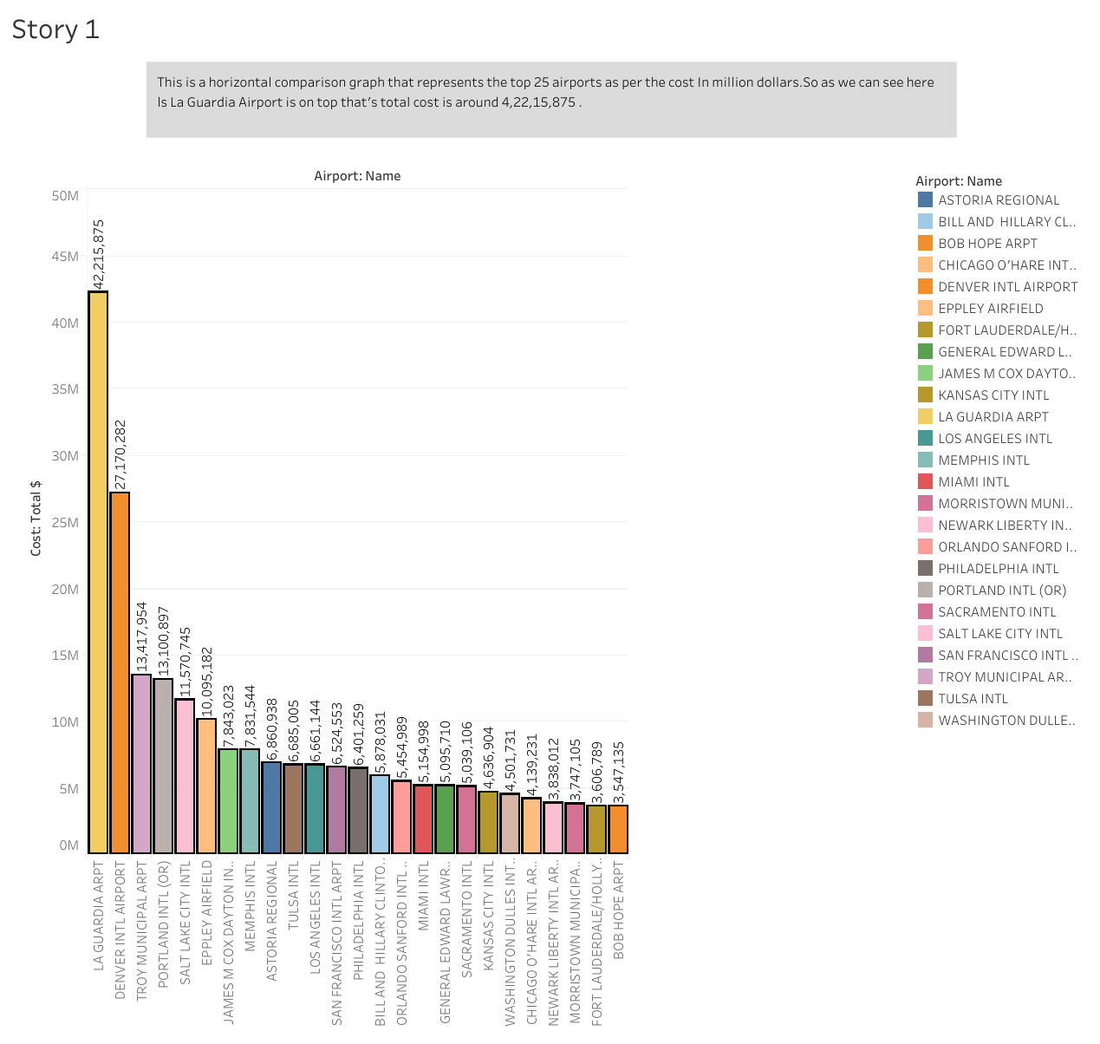
V-Graph This is a horizontal comparison graph that represents the top 25 airports as per the cost In million dollars. So as we can see here ls La Guardia Airport is on top that's total cost is around 4,22,15,875.

Slide 3
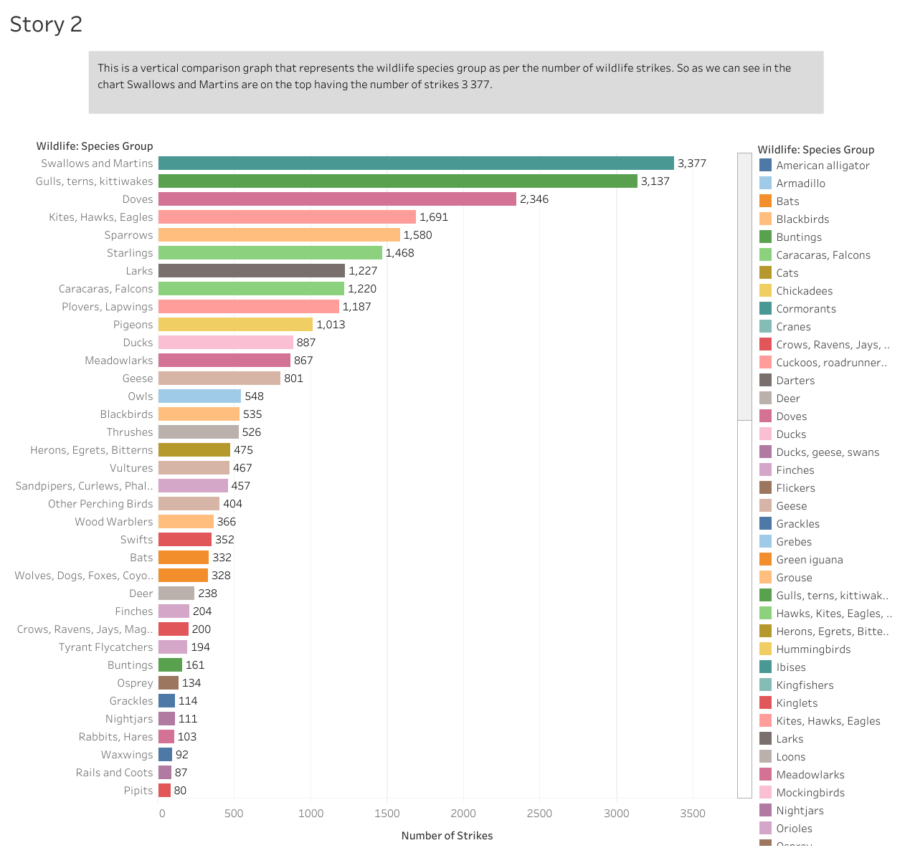
H-Graph
This is a vertical comparison graph that represents the wildlife species group as per the number of wildlife strikes. So as we can see in the chart Swallows and Martins are on the top having the number of strikes 3 377.

Slide 4
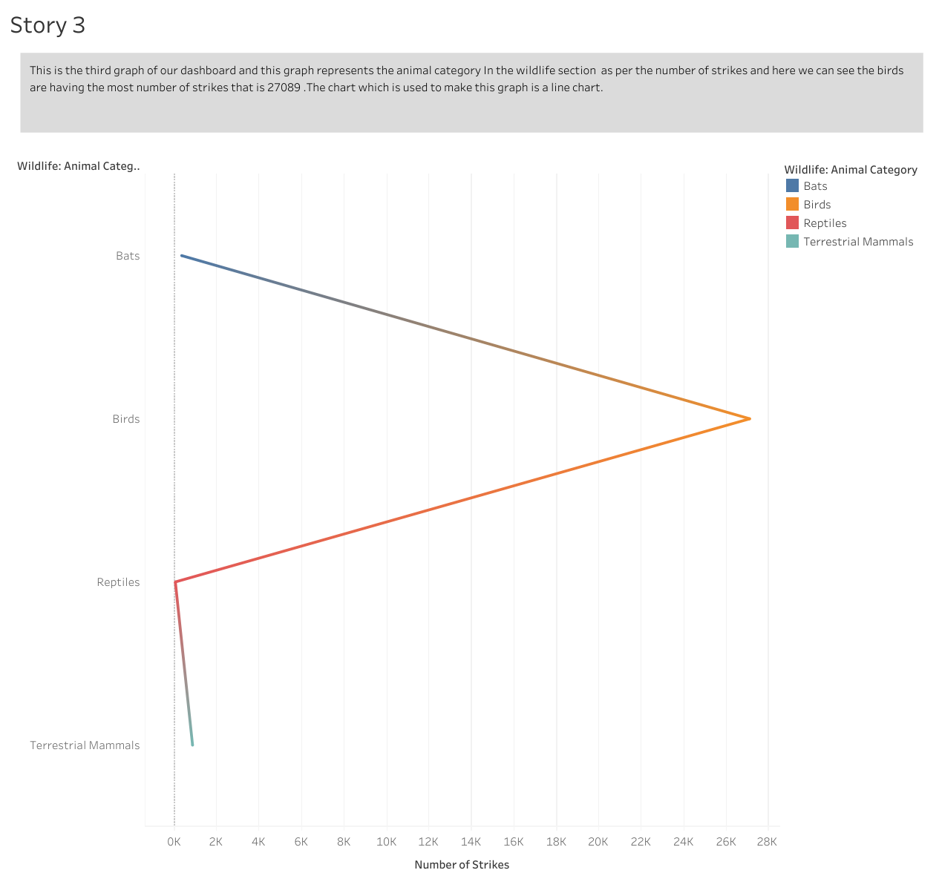
Line Graph
This is the third graph of our dashboard and this graph represents the animal category In the wildlife section as per the number of strikes and here we can see the birds are having the most number of strikes that is 27089 .The chart which is used to make this graph is a line chart.

Slide 5
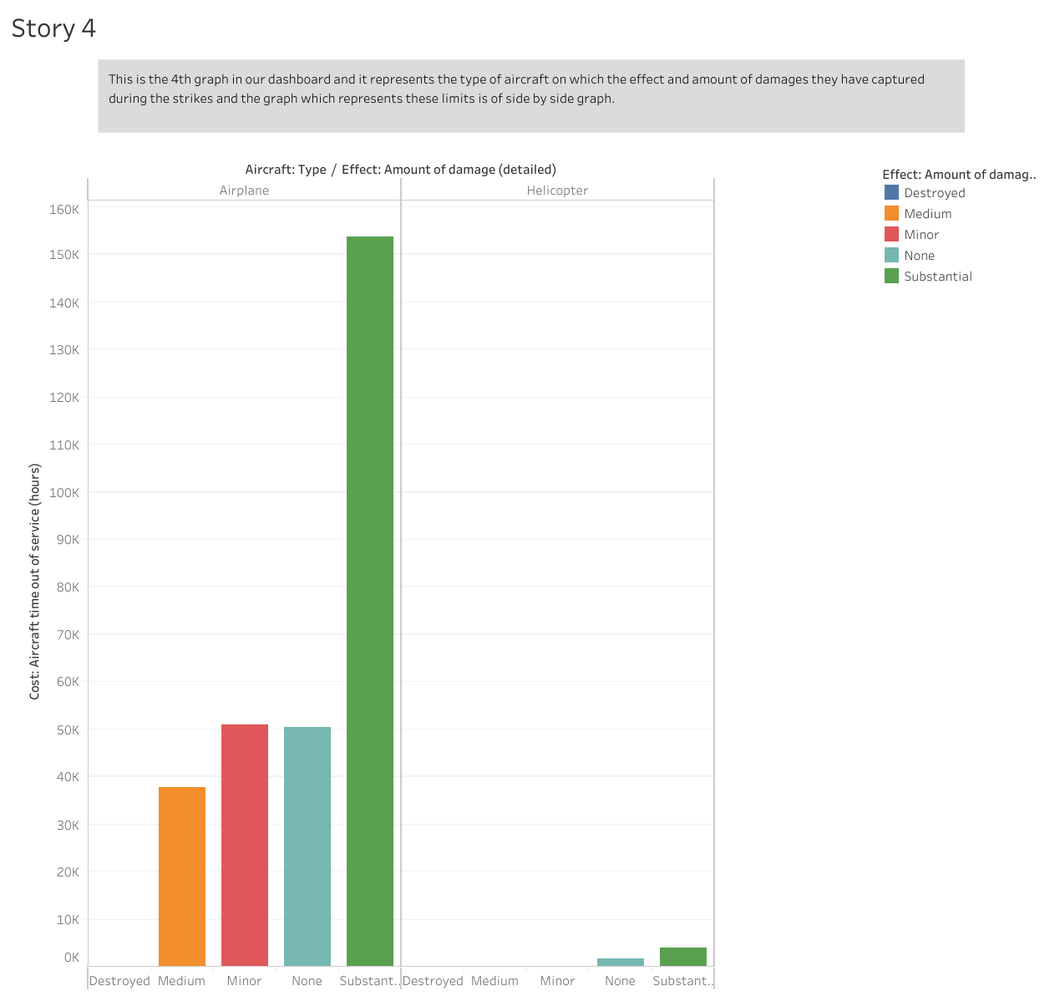
Side By Side Graph
This is the 4th graph in our dashboard and it represents the type of aircraft on which the effect and amount of damages they have captured during the strikes and the graph which represents these limits is of side by side graph.

Slide 6
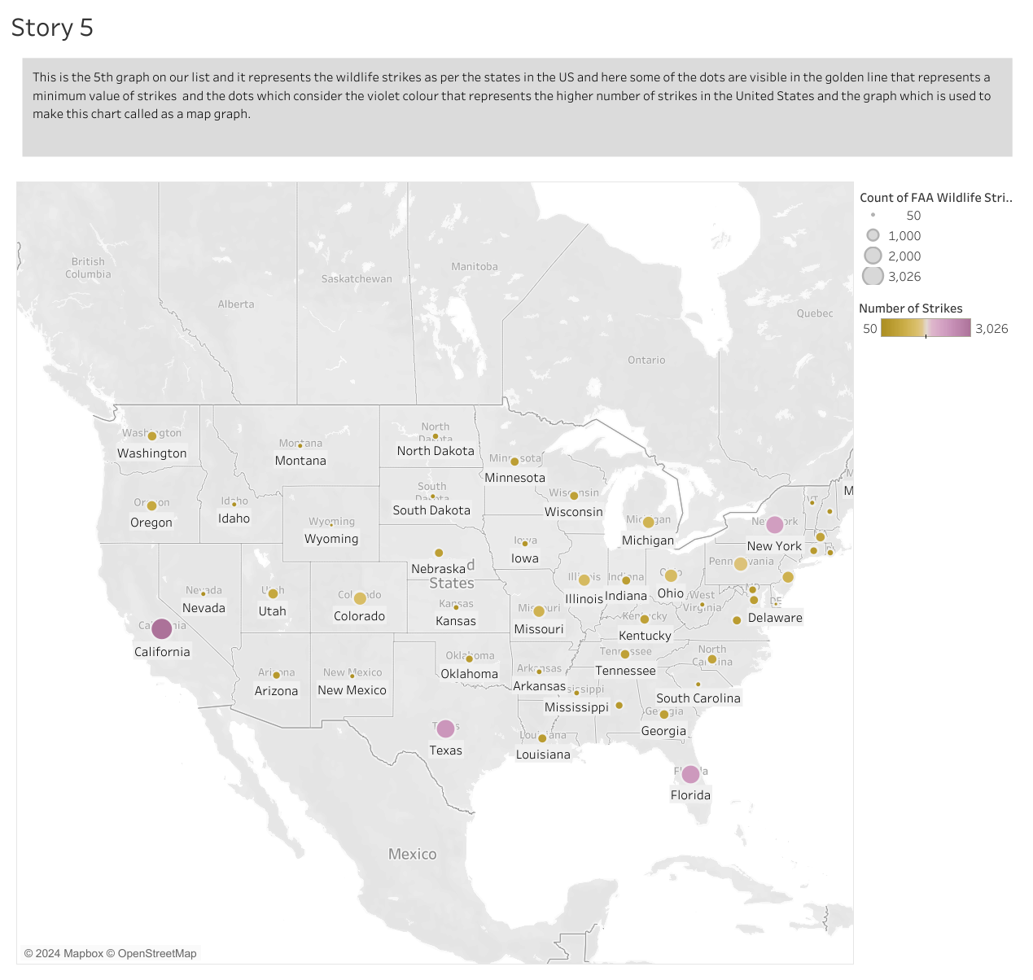
Map Graph
This is the 5th graph on our list and it represents the wildlife strikes as per the states in the US and here some of the dots are visible in the golden line that represents a minimum value of strikes and the dots which consider the violet colour that represents the higher number of strikes in the United States and the graph which is used to make this chart called as a map graph.

Slide 7
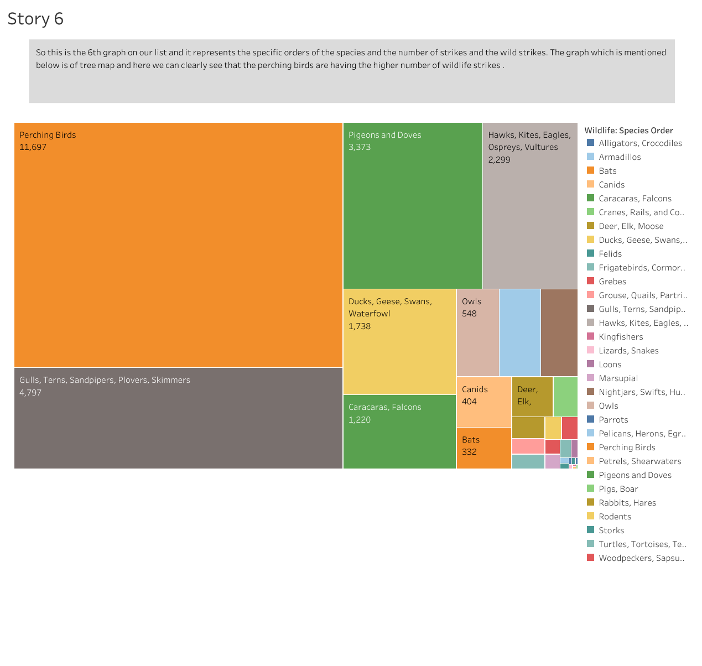
Tree Map
So this is the 6th graph on our list and it represents the specific orders of the species and the number of strikes and the wild strikes. The graph which is mentioned below is of tree map and here we can clearly see that the perching birds are having the higher number of wildlife strikes .

Slide 8
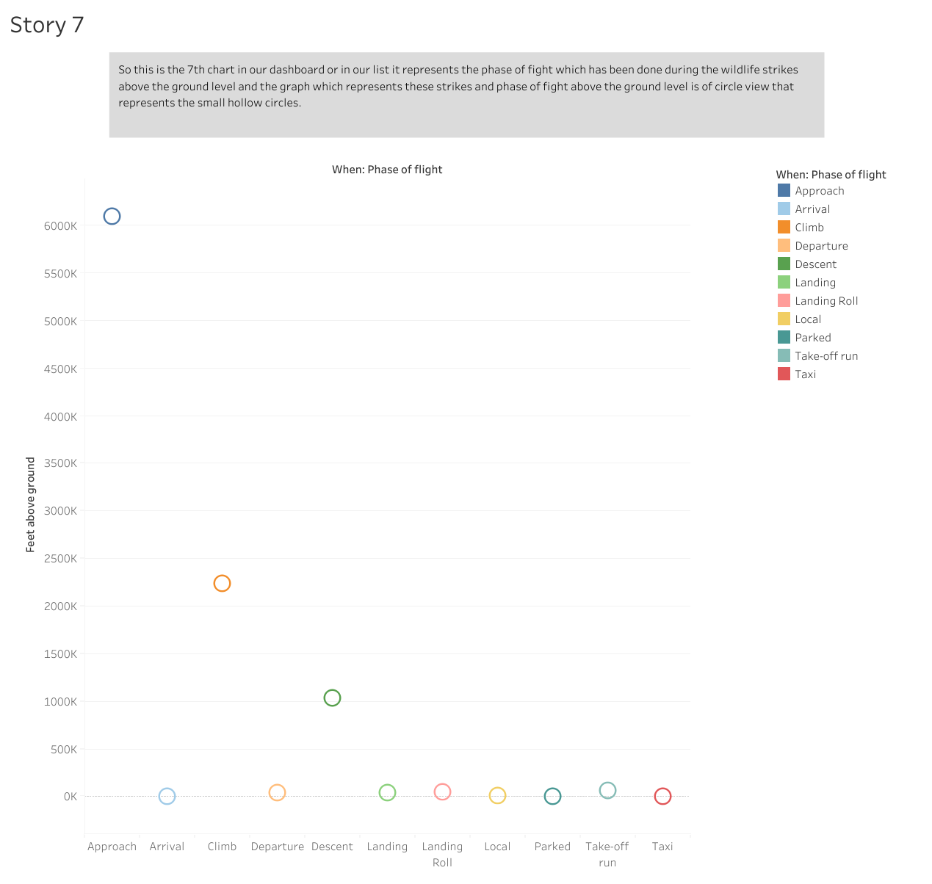
Circle View
So this is the 7th chart in our dashboard or in our list it represents the phase of fight which has been done during the wildlife strikes above the ground level and the graph which represents these strikes and phase of fight above the ground level is of circle view that represents the small hollow circles.

Slide 9
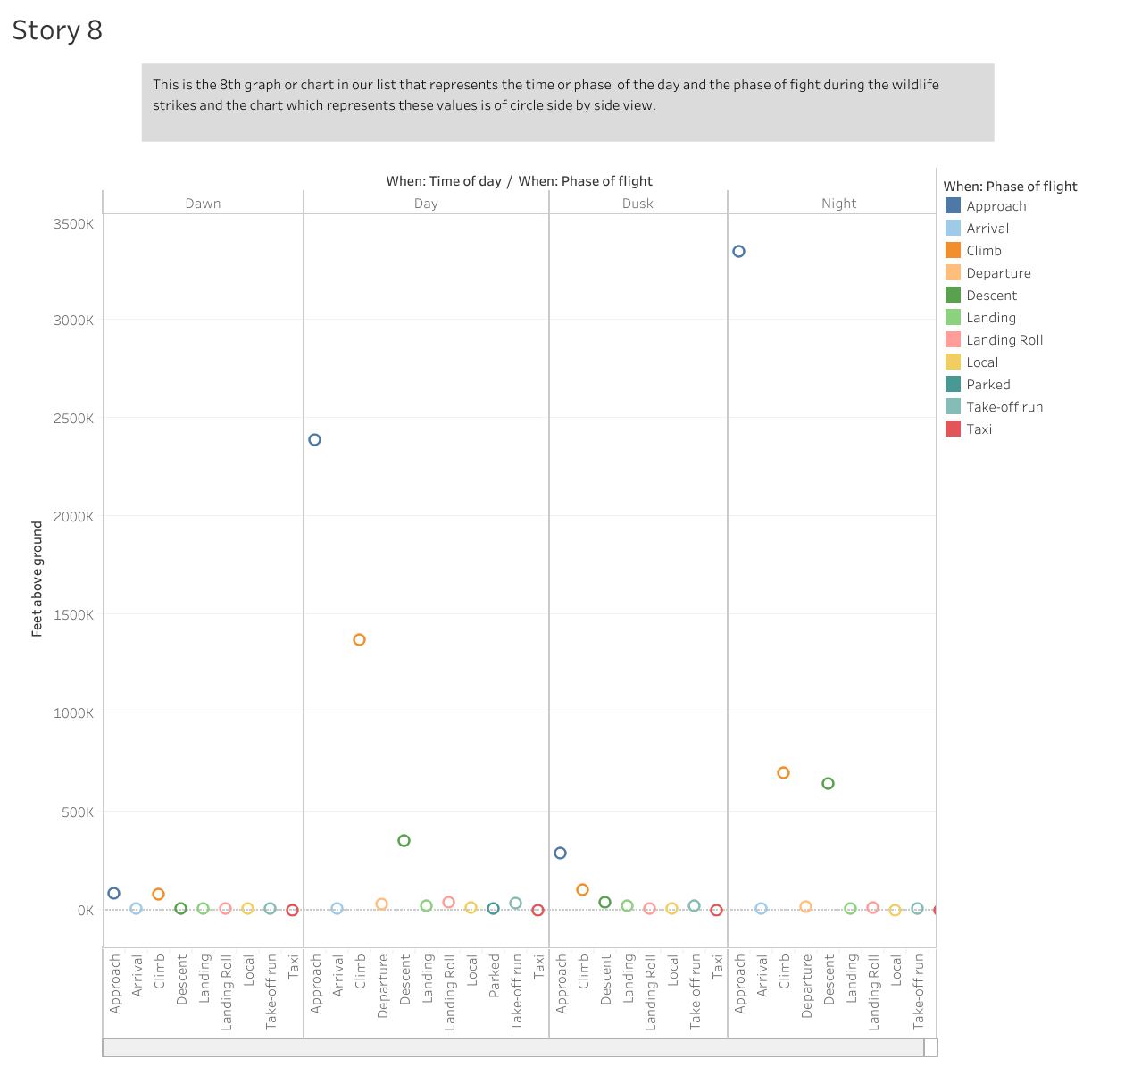
Side By Side Circle View
This is the 8th graph or chart in our list that represents the time or phase of the day and the phase of flight during the wildlife strikes and the chart which represents these values is of circle side by side view.

Slide 10
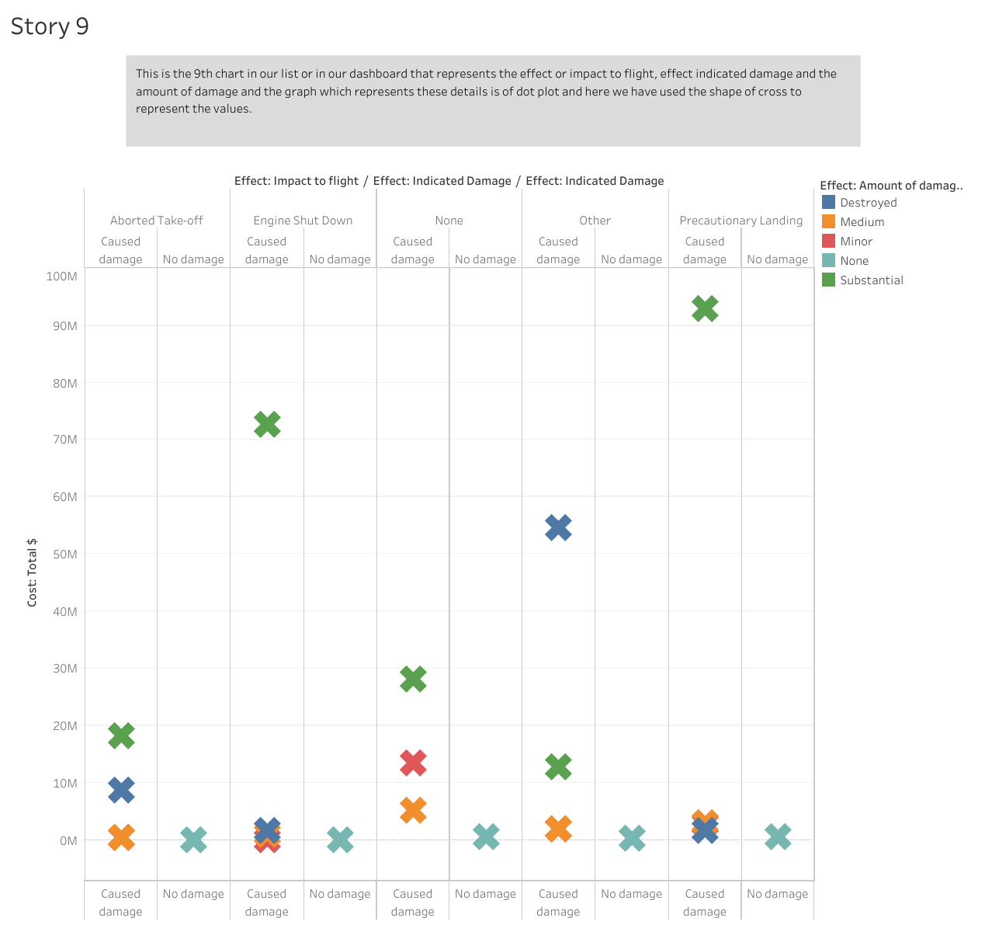
Dot Plot Graph
This is the 9th chart in our list or in our dashboard that represents the effect or impact to flight, effect indicated damage and the amount of damage and the graph which represents these details is of dot plot and here we have used the shape of cross to represent the values.

Slide 11
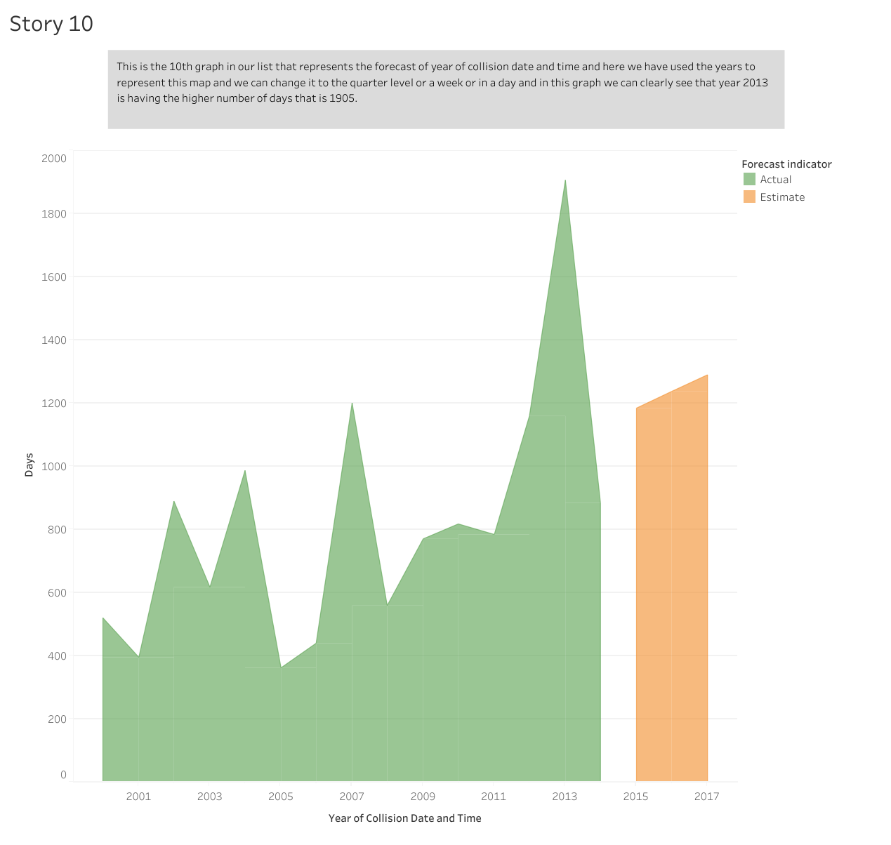
Forcasting This is the 10th graph in our list that represents the forecast of year of collision date and time and here we have used the years to represent this map and we can change it to the quarter level or a week or in a day and in this graph we can clearly see that year 2013 is having the higher number of days that is 1905.

Slide 12
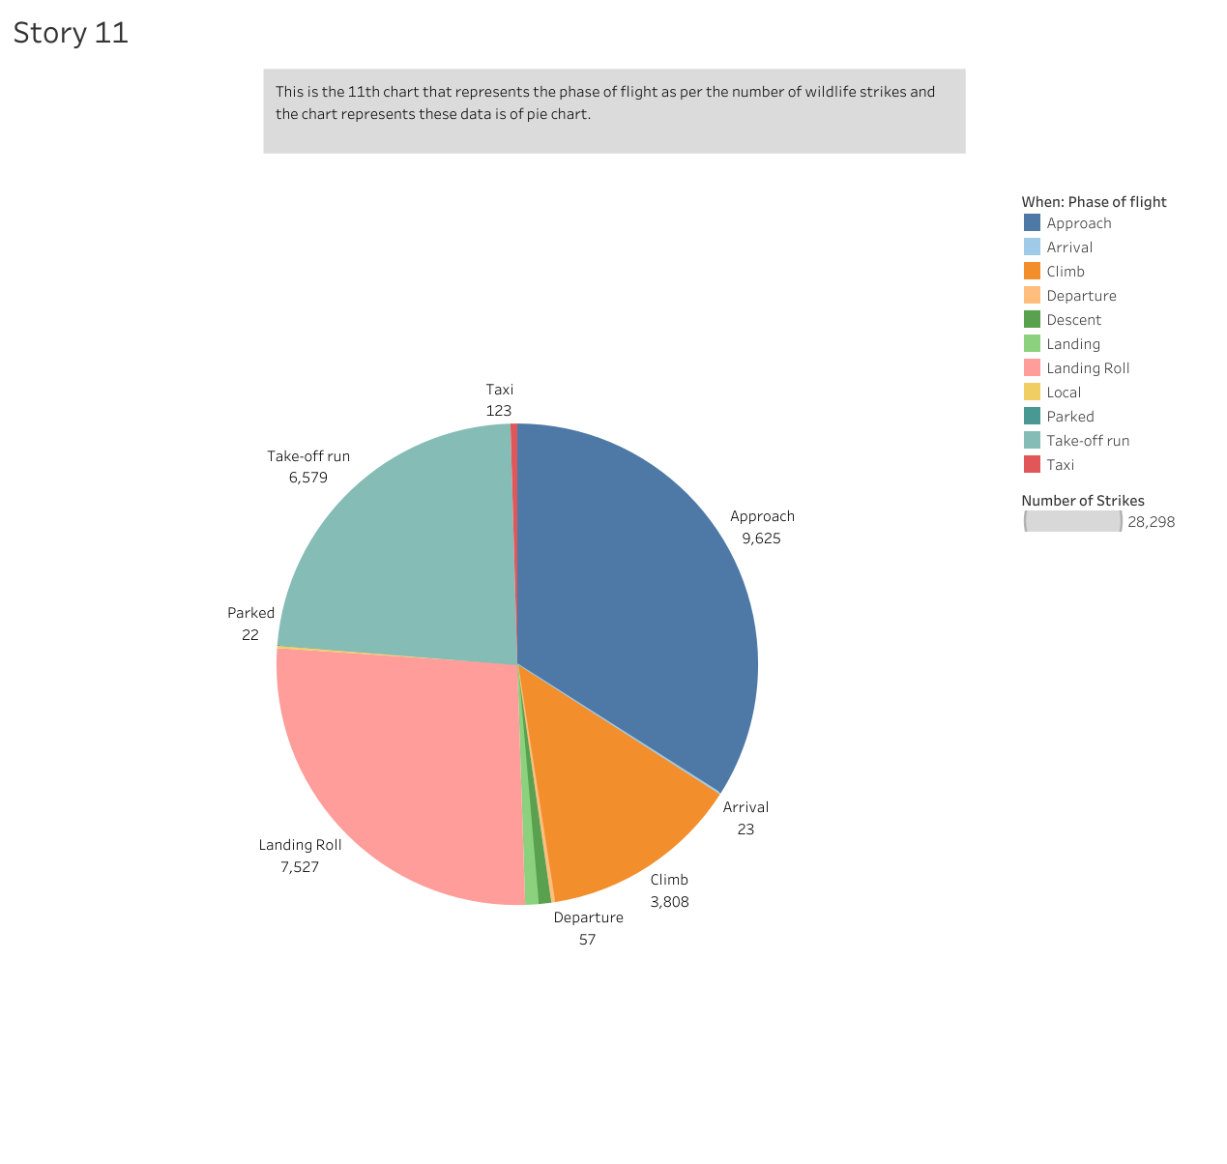
Pie Chart
This is the 11th chart that represents the phase of flight as per the number of wildlife strikes and the chart represents these data is of pie chart.

Slide 13
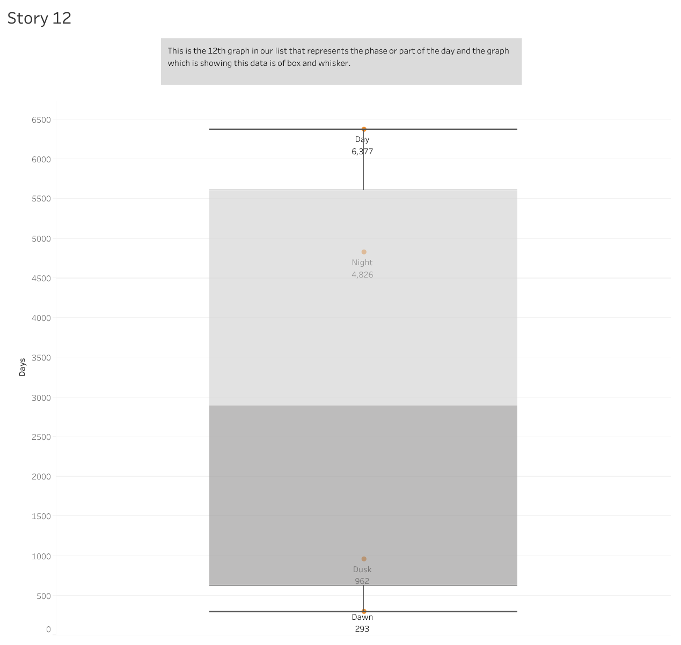
Box And Whisker
This is the 12th graph in our list that represents the phase or part of the day and the graph which is showing this data is of box and whisker.

Slide 14
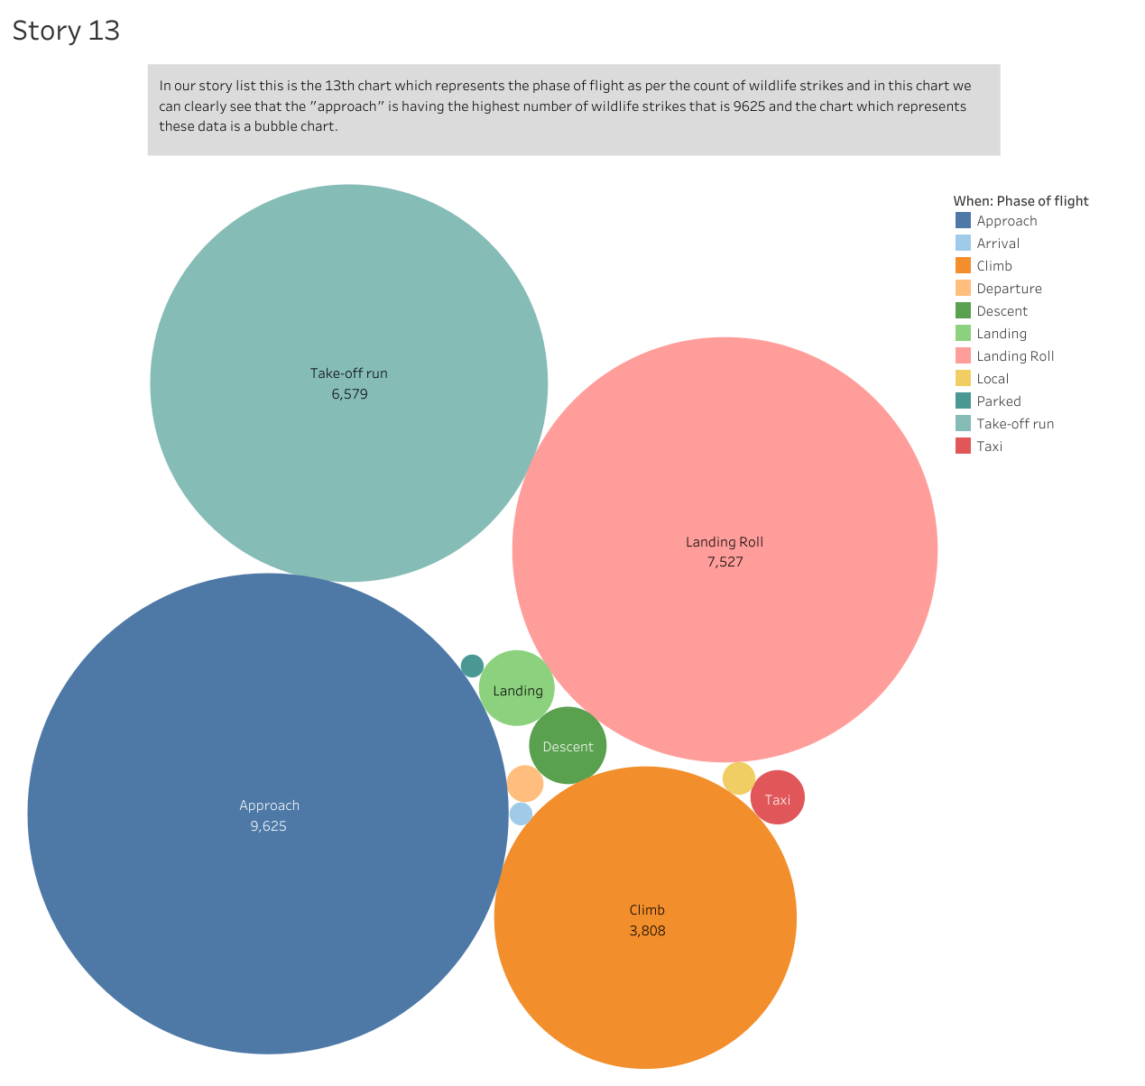
Bubble Graph
In our story list this is the 13th chart which represents the phase of flight as per the count of wildlife strikes and in this chart we can clearly see that the "approach" is having the highest number of wildlife strikes that is 9625 and the chart which represents these data is a bubble chart.

Slide 15
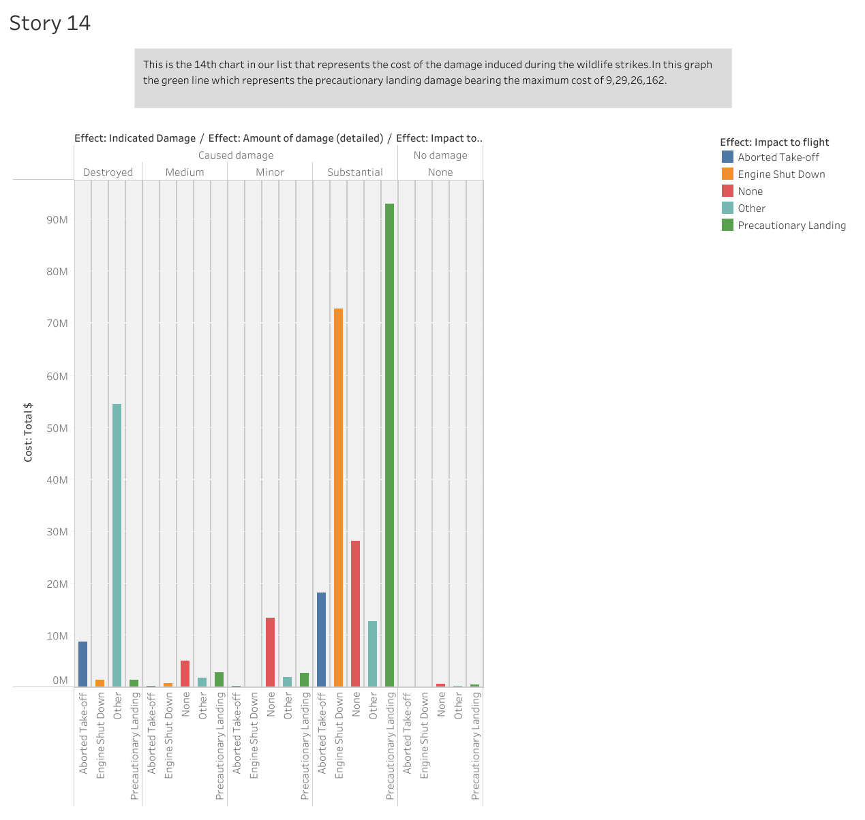
Bullet Graph
This is the 14th chart in our list that represents the cost of the damage induced during the wildlife strikes.In this graph the green line which represents the precautionary landing damage bearing the maximum cost of 9,29,26,162.

Slide 16
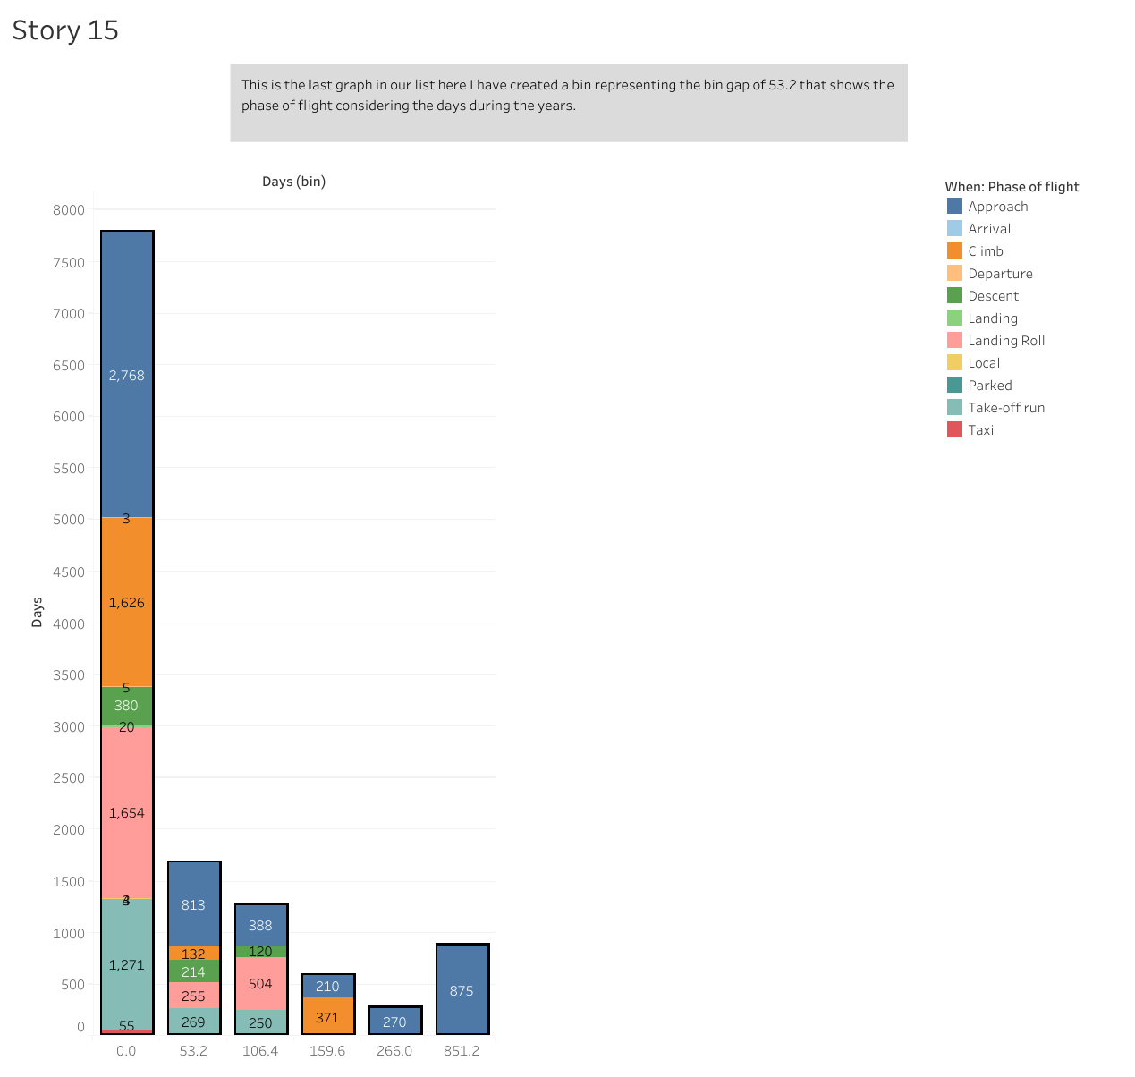
Bin Created
This is the last graph in our list here I have created a bin representing the bin gap of 53.2 that shows the phase of flight considering the days during the years.

Slide 17






